Slide 1
BCI Amplify Award Supplemental Material
1

Slide 2
Congressional Visits

Slide 3
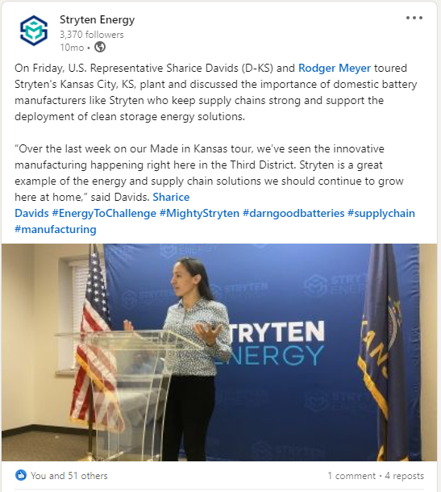
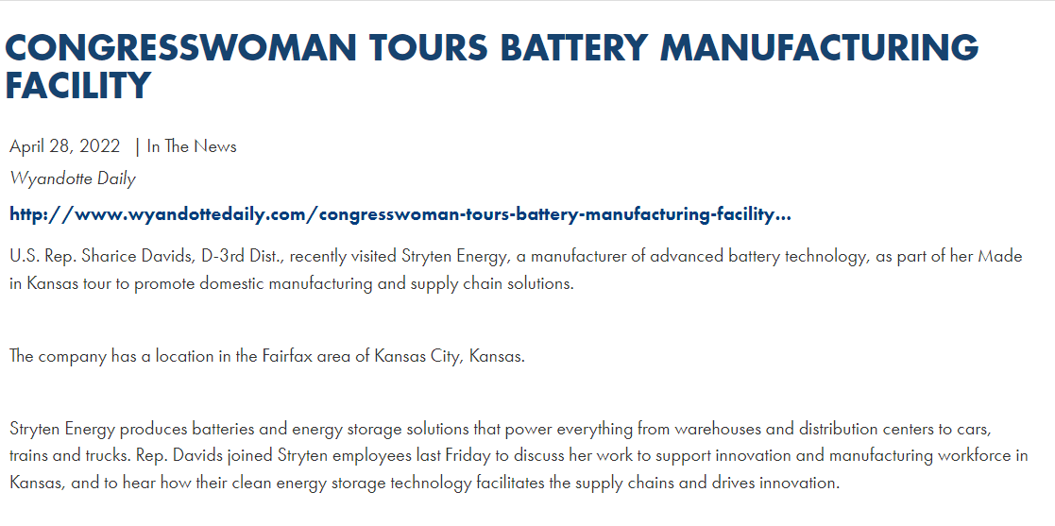
U.S. Representative Sharice Davids (D-KS) Visit
U.S. Representative Sharice Davids (D-KS) toured Stryten Energy's Kansas City, KS, plant
Social media post published 04/26/22
Press releases from Representative Davids’ office about her visit to Stryten Energy facility

Slide 4
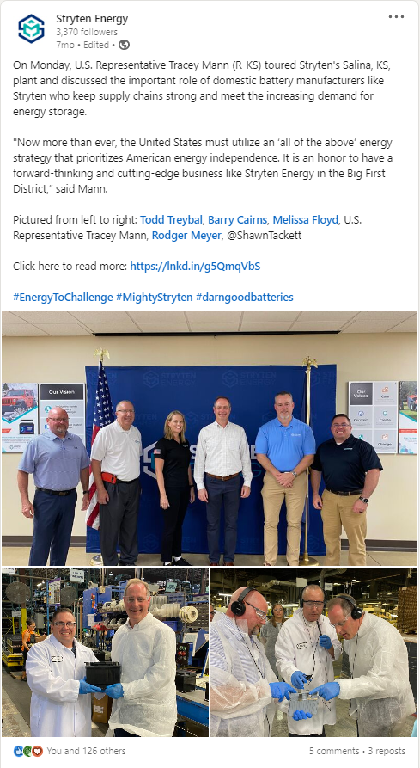
U.S. Representative Tracey Mann (R-KS) Visit
U.S. Representative Tracey Mann (R-KS) toured Stryten Energy's Salina, KS, plant
Social media post published 06/23/22

Slide 5
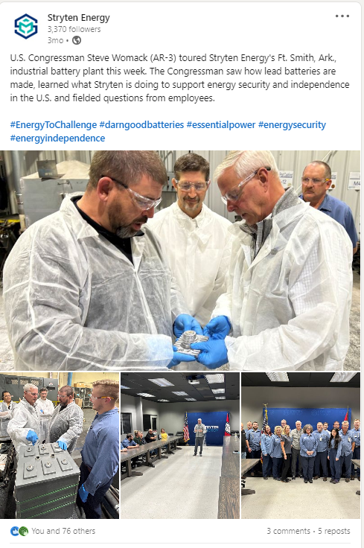
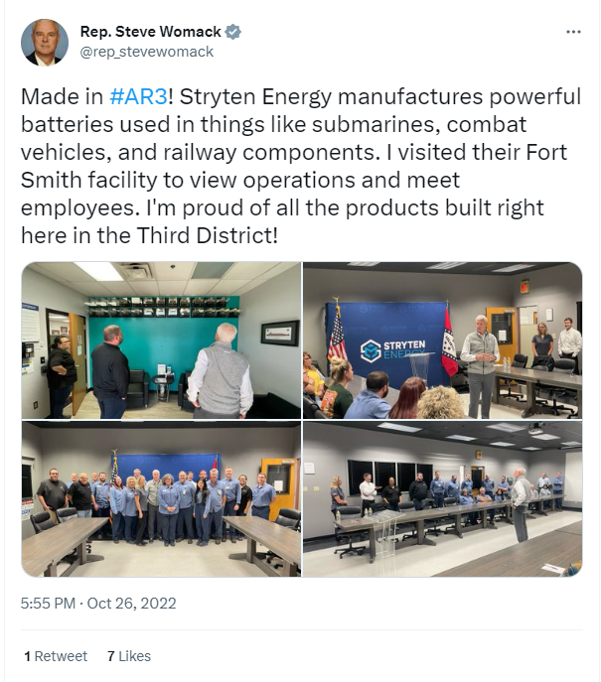
U.S. Congressman Steve Womack (AR-3) Visit
U.S. Congressman Steve Womack (AR-3) toured Stryten Energy's Ft. Smith, Ark., industrial battery plant
Social media post published 10/28/22

Slide 6
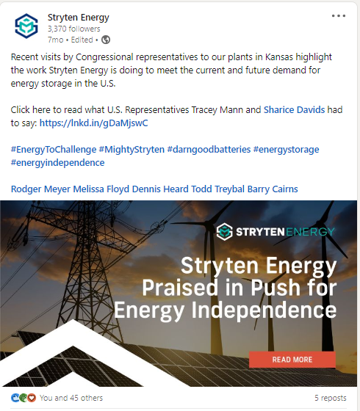
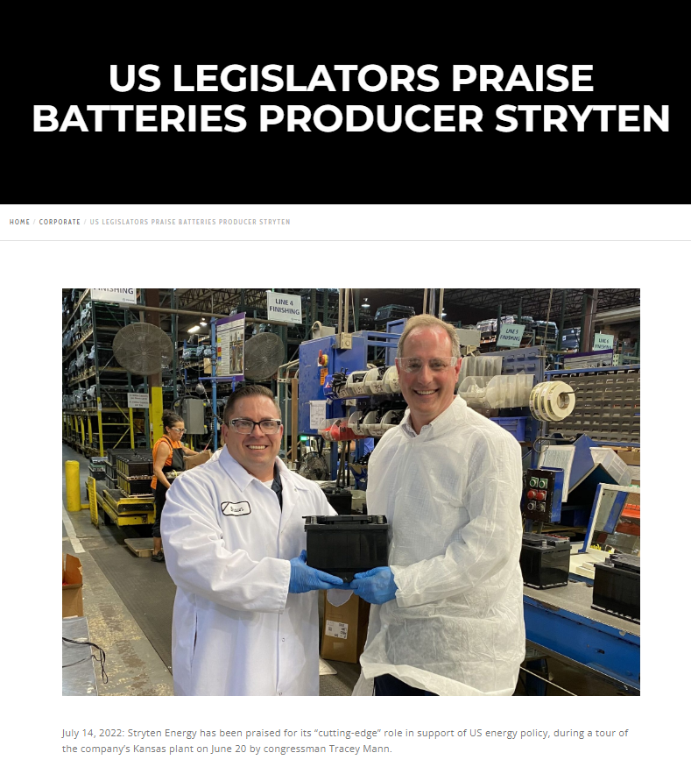
Batteries International Article About Visits
US Legislators Praise Battery Producer Stryten Energy
Published 07/14/22

Slide 7
Byline Articles and Industry Interviews

Slide 8
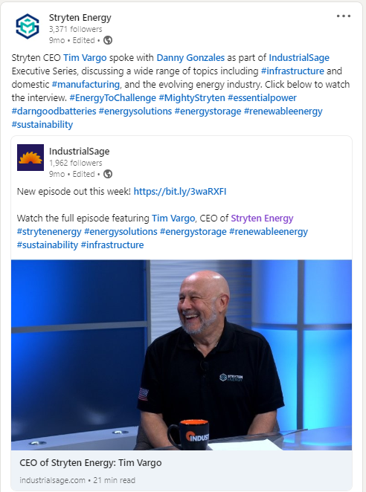
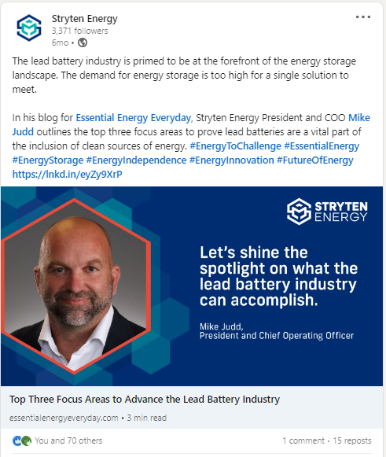
Stryten Energy CEO Tim Vargo Featured in Executive Interview Series
Interview published 05/10/22 by IndustrialSage
Top Three Focus Areas to Advance the Lead Battery Industry
Article published 07/26/22 in Essential Energy Everyday

Slide 9
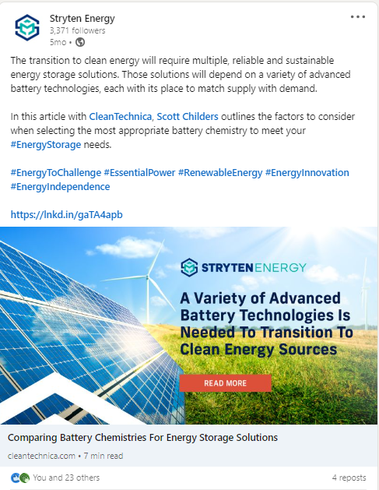
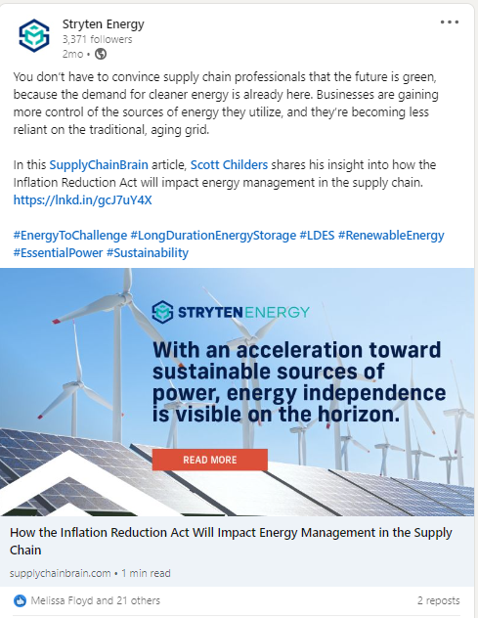
Comparing Battery Chemistries For Energy Storage Solutions
Article published 08/31/22 in CleanTechnica
How the Inflation Reduction Act Will Impact Energy Management in the Supply Chain
Article published 11/15/22 in SupplyChainBrain

Slide 10
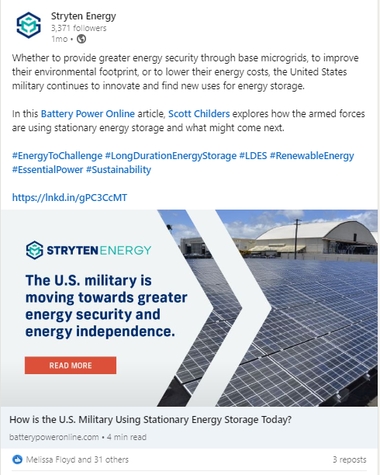
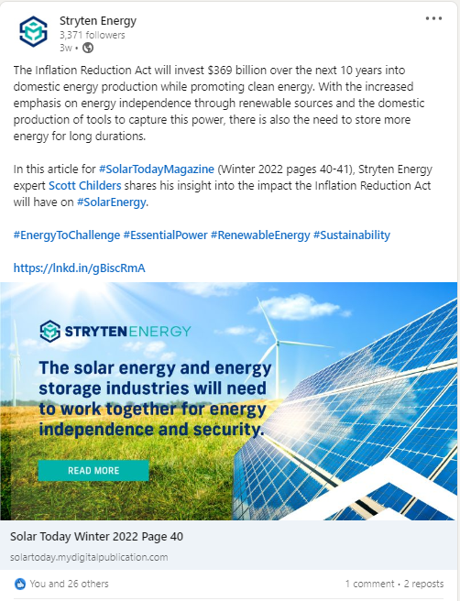
How is the U.S. Military Using Stationary Energy Storage Today?
Article published 12/19/22 in Battery Power
Two Major Impacts the Inflation Reduction Act Will Have on Solar
Article published 12/22/22 in Solar Today

Slide 11
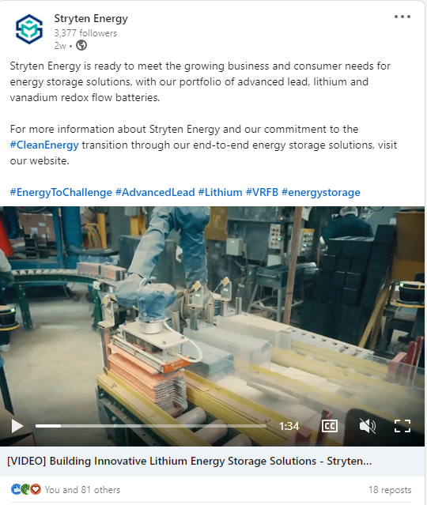
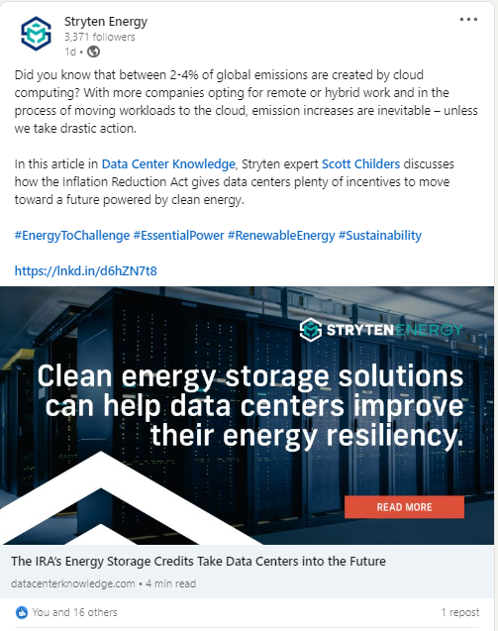
Building Innovative Lithium Energy Storage Solutions
Thought leadership video published 01/19/23
The IRA’s Energy Storage Credits Take Data Centers into the Future
Article published 01/27/23 in Data Center Knowledge

Slide 12
Thought Leadership Blogs

Slide 13
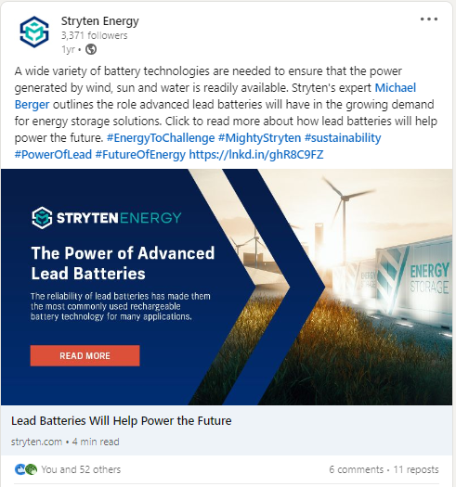
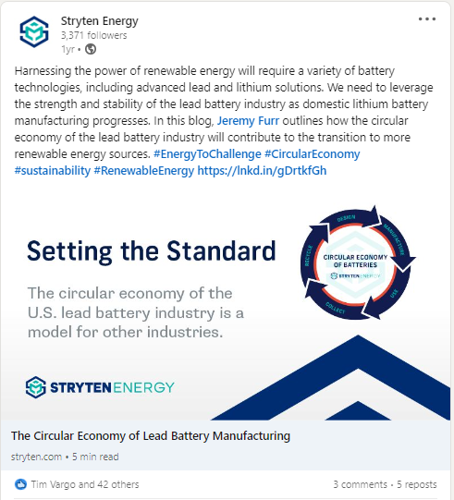
Reliable Energy Storage: Lead Batteries Will Help Power the Future
Blog published 01/11/22
The Circular Economy of Lead Battery Manufacturing
Blog published 02/08/22

Slide 14
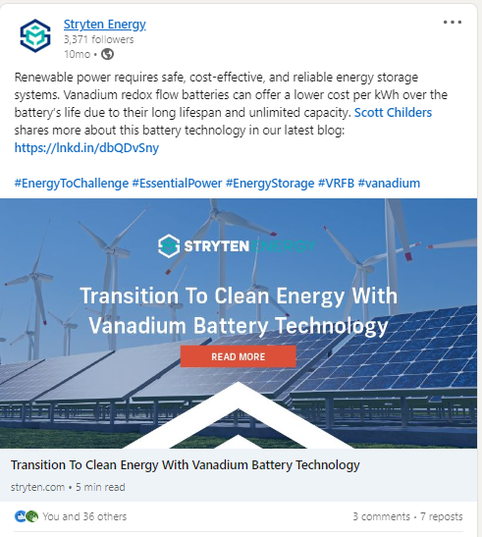
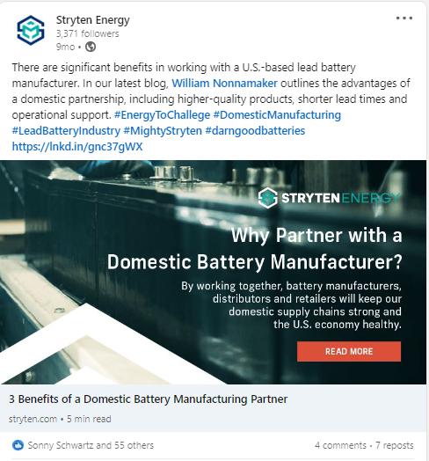
Transition to Clean Energy With Vanadium Battery Technology
Blog published 04/05/22
Three Benefits of a Domestic Battery Manufacturing Partner
Blog published 05/18/22

Slide 15
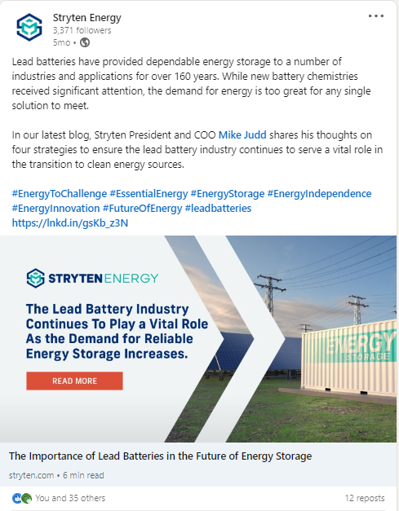
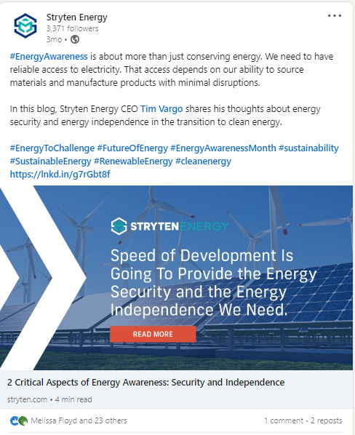
The Importance of Lead Batteries in the Future of Energy Storage
Blog published 08/24/22
Two Critical Aspects of Energy Awareness: Security and Independence
Blog published 10/11/22

Slide 16
Press Releases

Slide 17
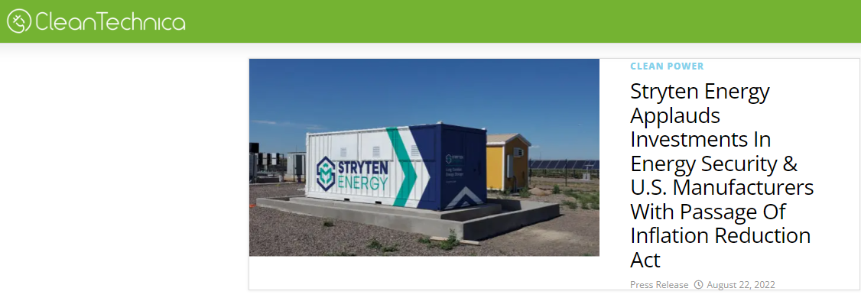
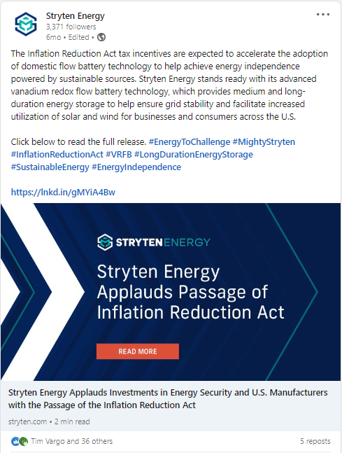
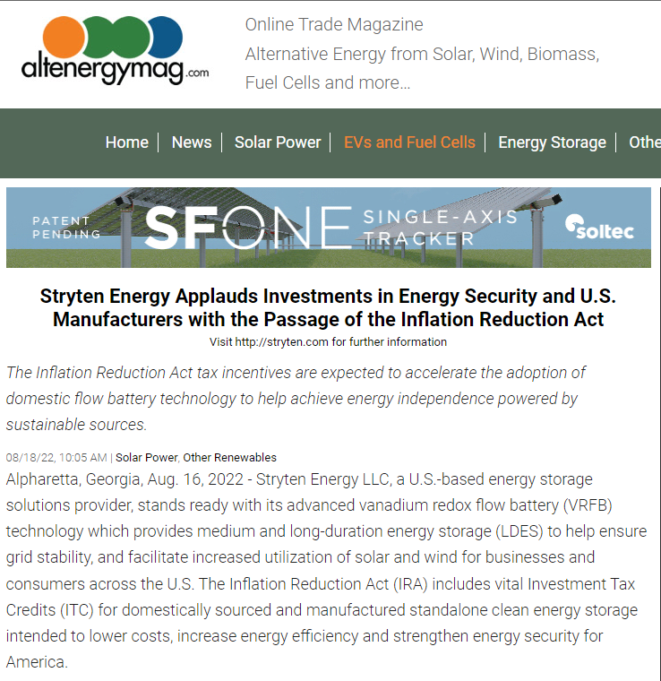
Stryten Energy Applauds Investments in Energy Security and U.S. Manufacturers with the Passage of the Inflation Reduction Act
Released 08/16/22
Also published in CleanTechnica and AltEnergy Mag

Slide 18
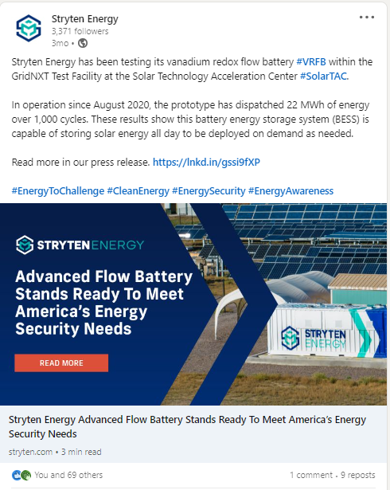
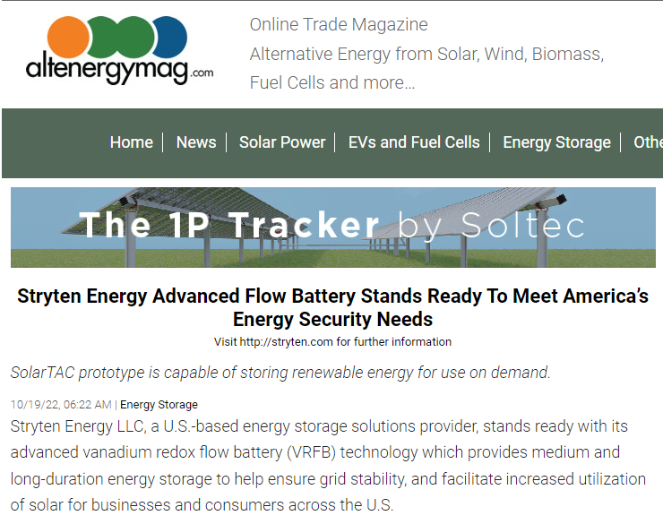
Stryten Energy Advanced Flow Battery Stands Ready To Meet America’s Energy Security Needs
Released 10/19/22
Also published in AltEnergyMag

Slide 19
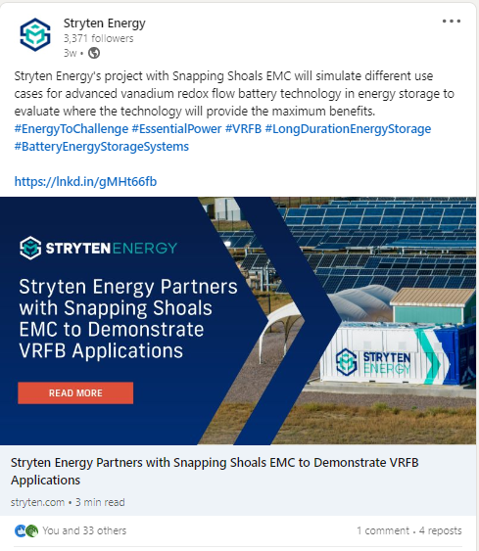
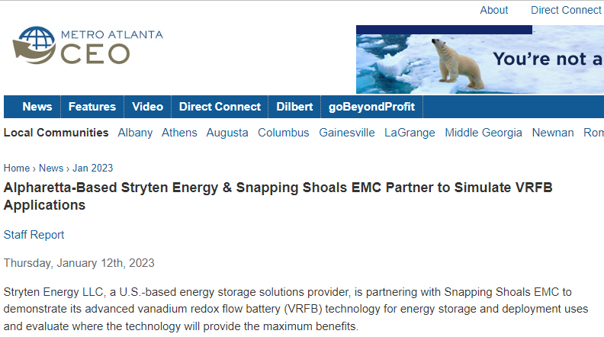
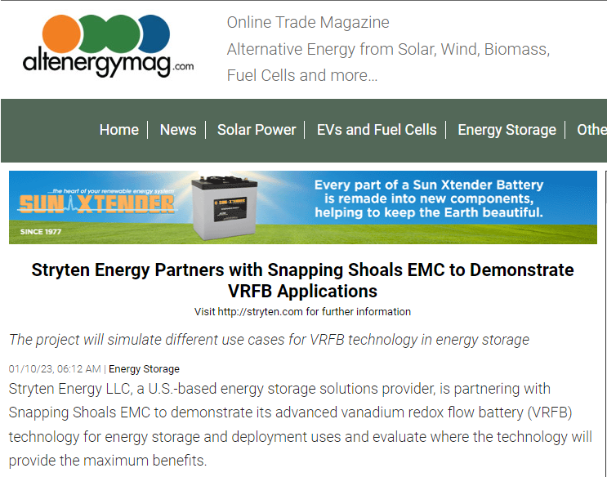
Stryten Energy Partners with Snapping Shoals EMC to Demonstrate VRFB Applications
Released 01/10/23
Also published in Metro Atlanta CEO and AltEnergyMag

Slide 20
BRAND
Our Vision
To solve the world’s most pressing energy challenges.
To be the most trusted energy partner.
To bring endless energy to everything we do.
20
Notes:
PRESENTER NOTES: Our vision and brand promise for Stryten Energy is:
To solve the world’s most pressing energy challenges.
To be the most trusted energy partner.
To bring endless energy to everything we do.
Our vision is our promise to keep growing and challenging the status quo to deliver top-performing energy solutions for today and tomorrow.

